Slide 1

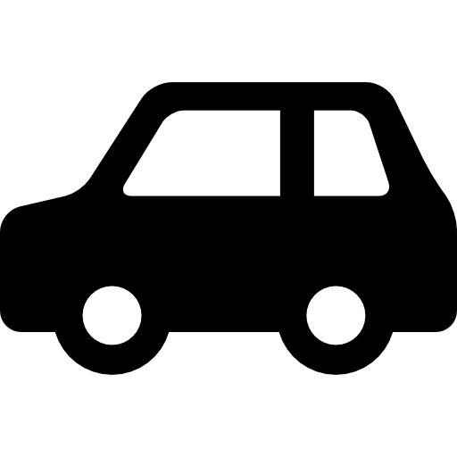
Smart City 2020
-
Car Crash Detection
ITD - Interaktionskonzept
Bruno Berger
Matr Nr: 2170706

Slide 2
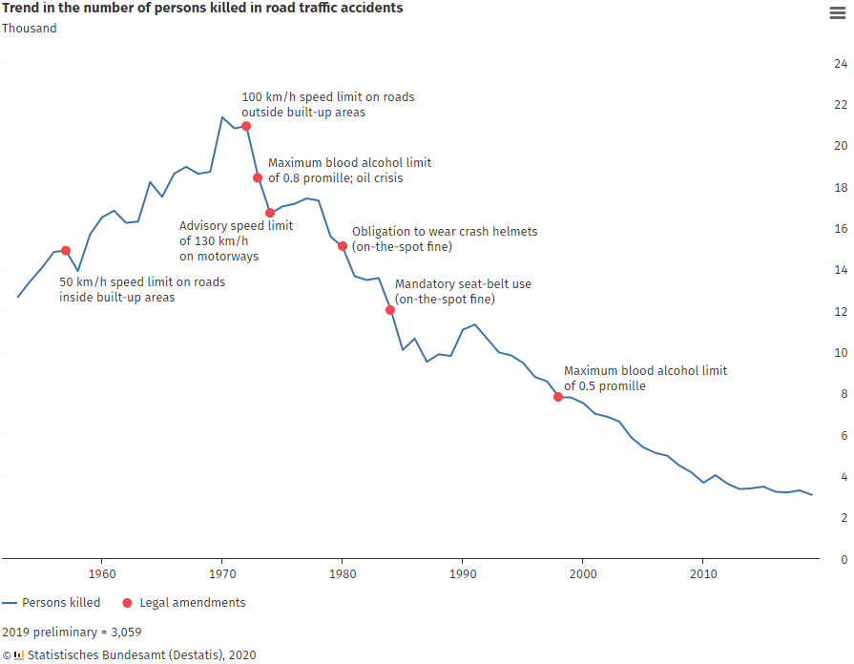
Motivation

Slide 3
Motivation
Still about 3000 deaths per year
Other ways to save lives?
→ Make accidents less deadly
Improve response time
Monitor all cars

Slide 4
Set parameters
CARLA for visualisation
  → Python API
MQTT for communication
Git for version control

Slide 5
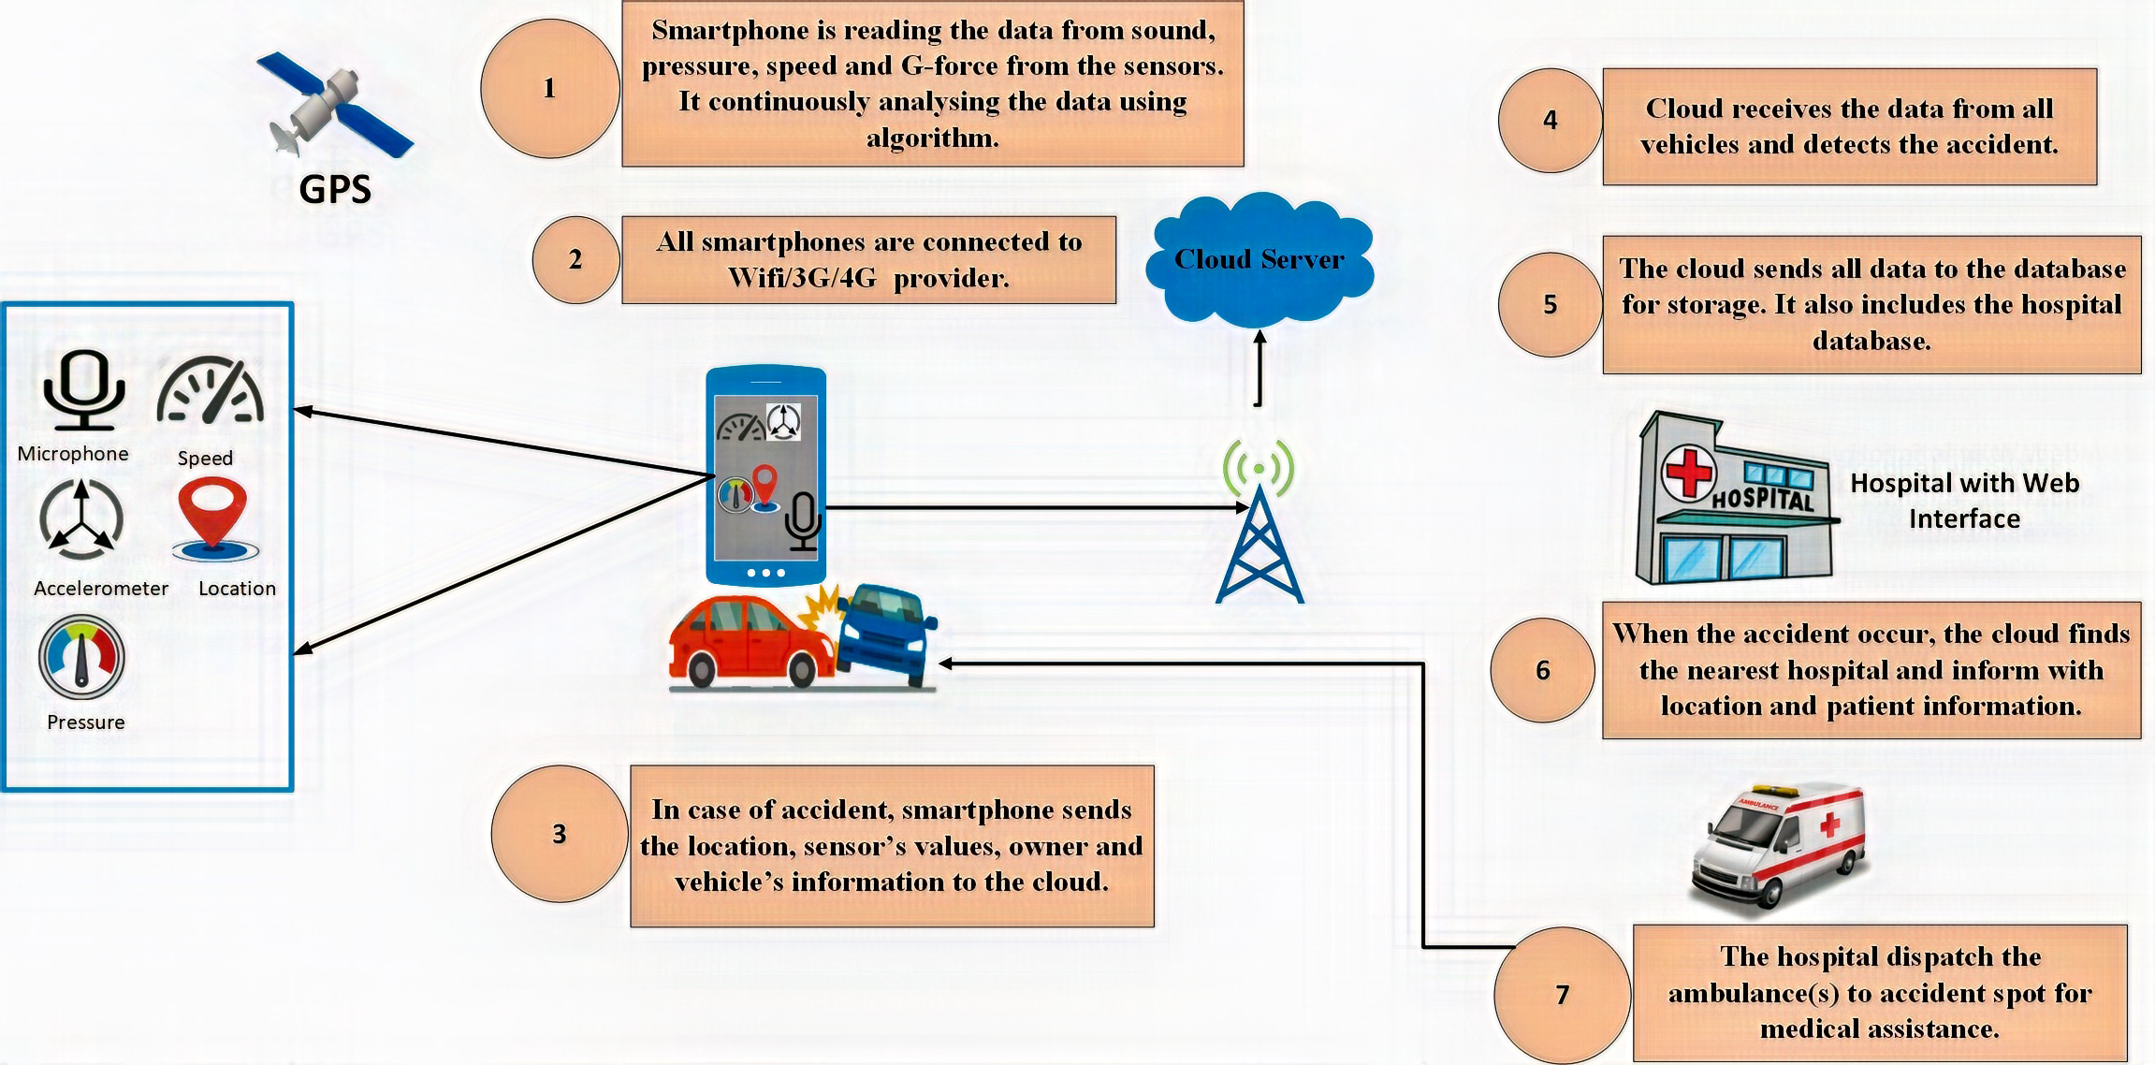
Research
COMSAS University:

Slide 6
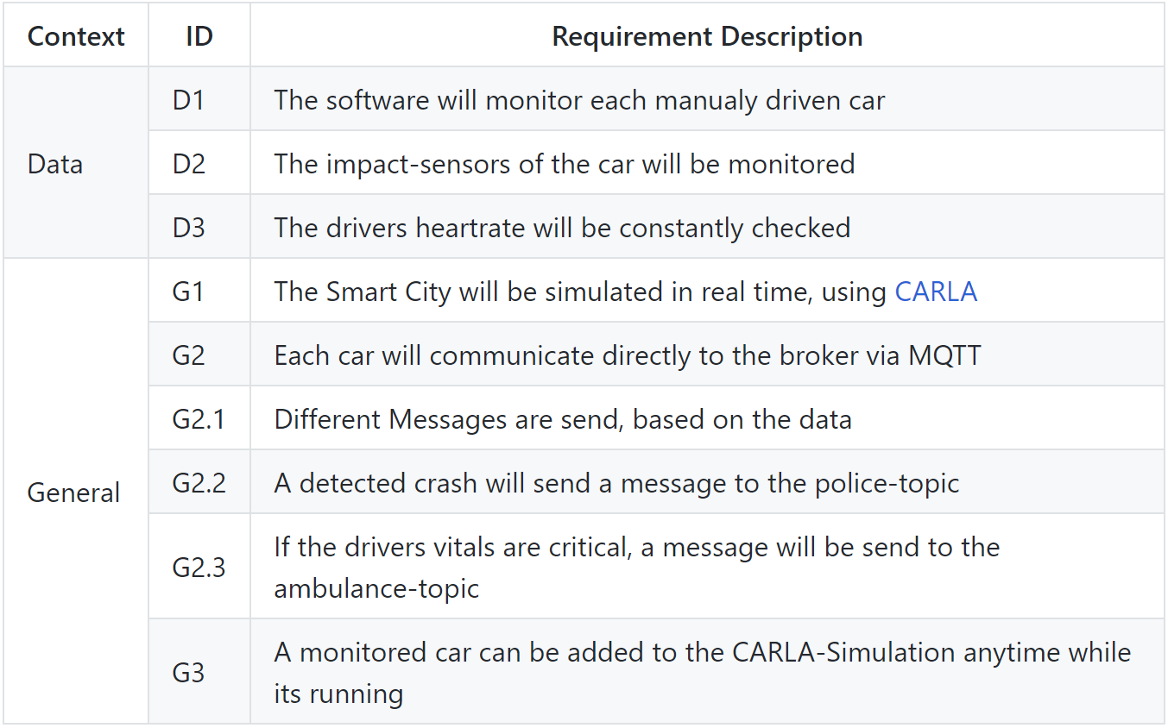
Concept - Requirements

Slide 7
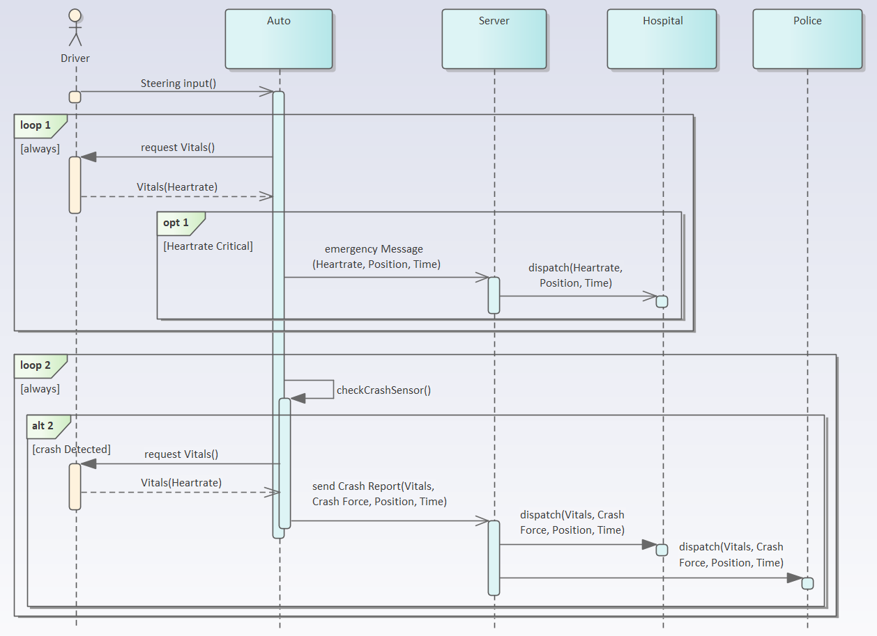
Concept – Sequence Chart

Slide 8
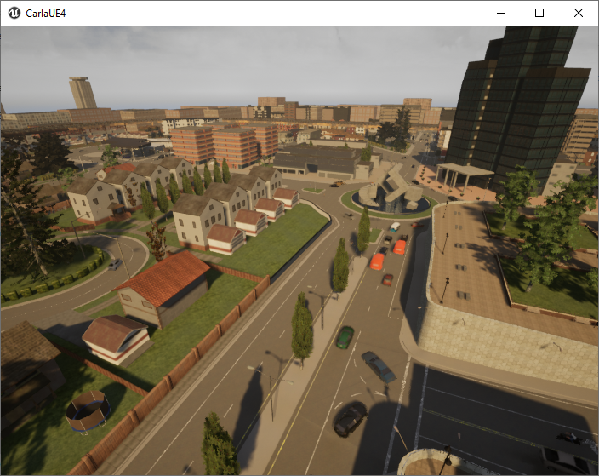
Implementation
Separate CARLA simulation
Hosted on own PC
Drivers connect to the simulation via internet

Slide 9
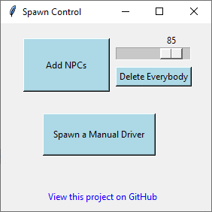
Implementation
Central for User interactions
Build with Tkinter package
  Slider for Number of NPCs
  Link to GitHub

Slide 10
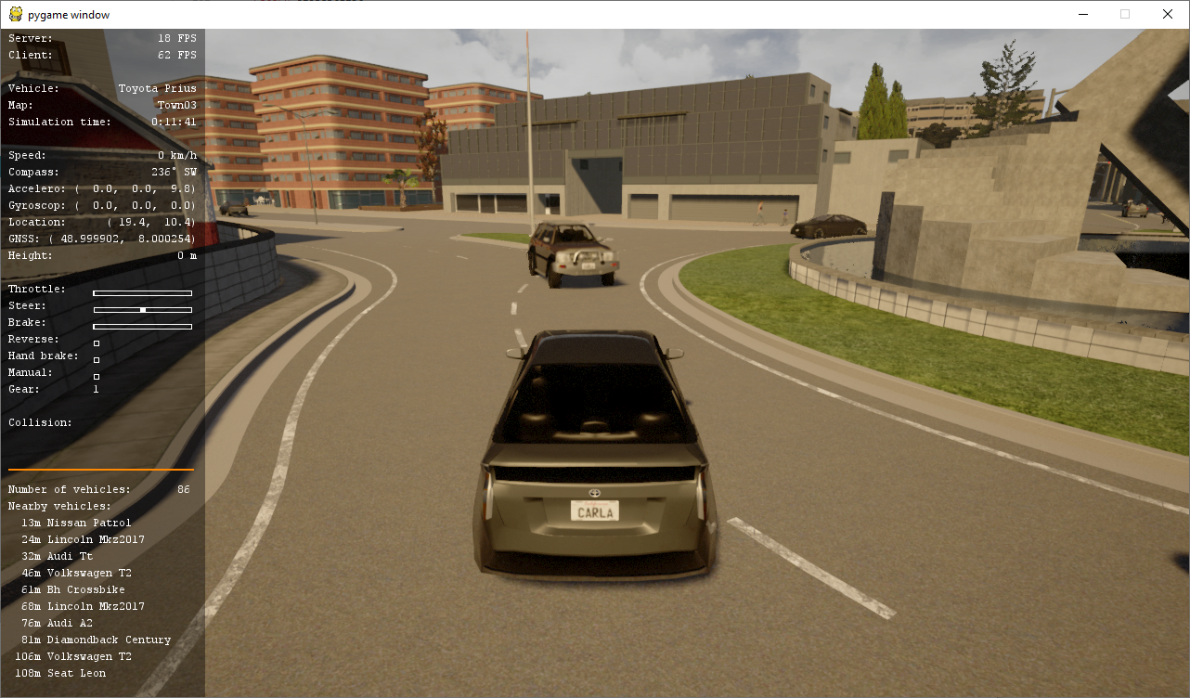
Implementation – Manual Driver

Slide 11
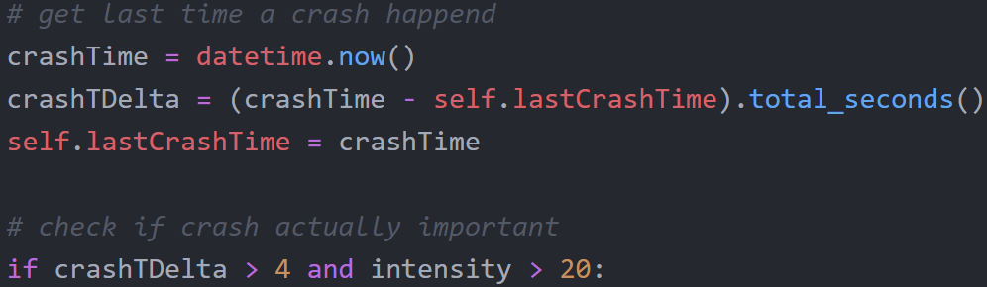
Implementation – Manual Driver
Filter:
  Check last crash time
  Check intensity

Slide 12
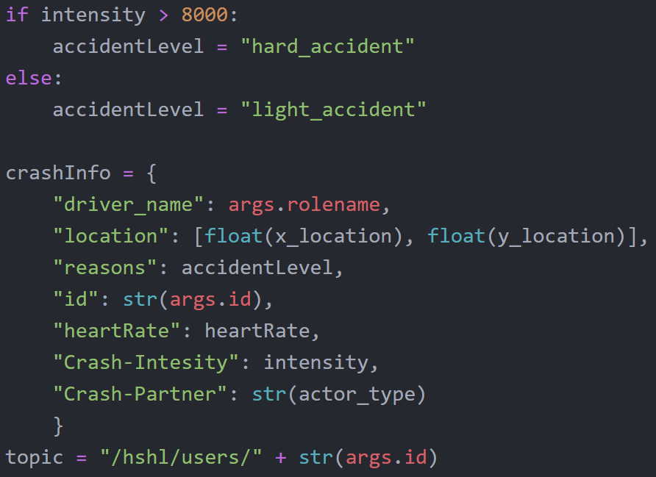
Implementation – Manual Driver
Crash-Information:
Guessing
seriousness
More info than needed
geopy-package
issue

Slide 13
Conclusion
Running the simulation,
Crash Detection,
Communication with server,
→ work

Slide 14
Conclusion

Slide 15
Future Work – Possible Features
Make use of all data
Monitor all NPCs
  Let some crash randomly
Implement whole Smart City in CARLA

Slide 16
Unanswered Questions?

